Slide 1
Report from KEK
High gradient study results from Nextef
(+ other related activities)
LCWS2011, Granada
Sep. 27, 2011
T. Higo

Slide 2
Contents
Recent high gradient study at Nextef
Structure fabrication status
Preparation of another test stand.

Slide 3
Recent high gradient study at Nextef
T24_Disk_#3
  HG study in a usual manner
  Earthquake and following deterioration
  Total phase advance
TD24_Disk_#4
  Initial processing status

Slide 4
T24 versus TD24
Design by A. Grudiev
Average unloaded of 100 MV/m
Difference is in pulse heating

Slide 5
HG test result on T24#3
High gradient performance
  BDR evolution
  BDR at 100MV/m
  Damage
Deterioration due to earthquake
  Air exposure

Slide 6
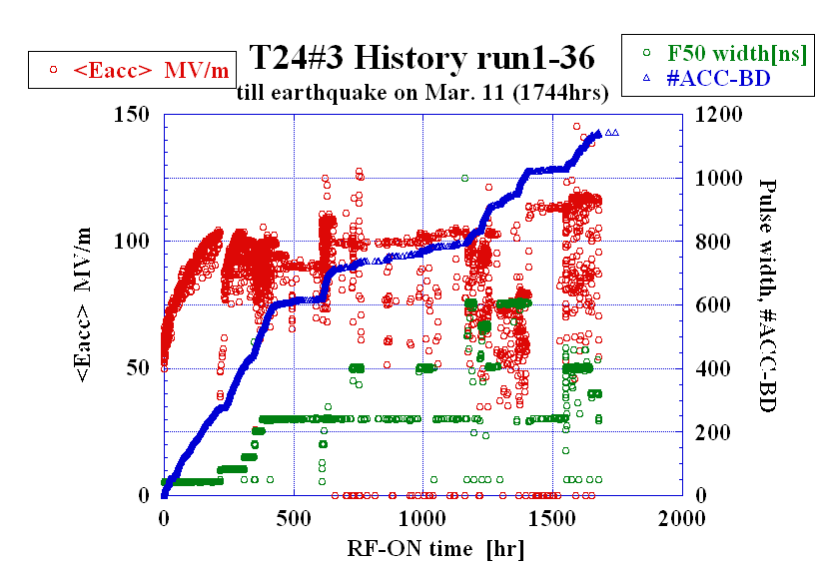
Processed for 1744 hours.

Slide 7
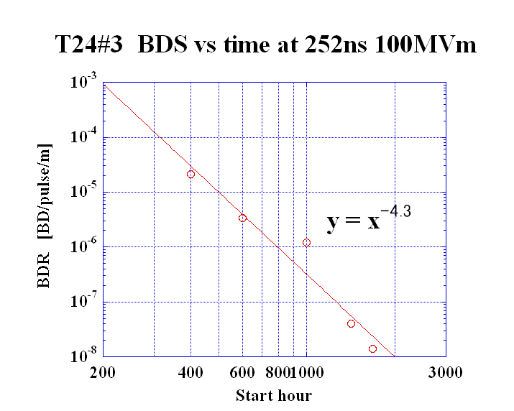
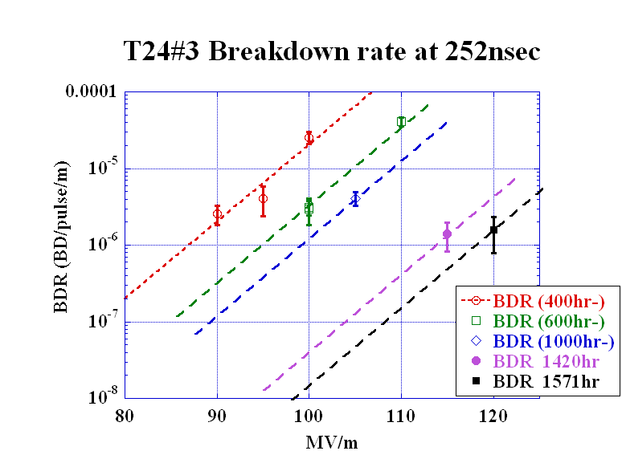
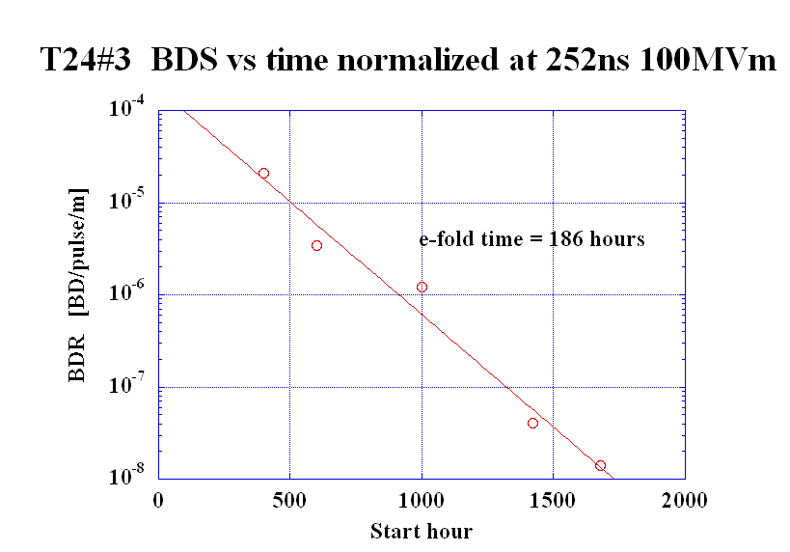
T24#3
BDR evolution at 252ns normalized 100MV/m
Assuming the same exponential slope as that at 400hr
We understand the BDR has been kept decreasing.

Slide 8
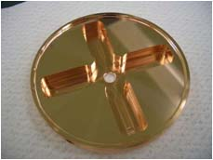
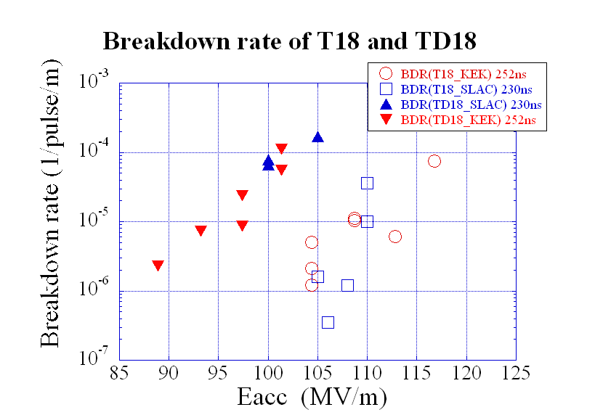
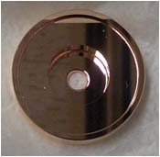
Comparison of BDR in
T18, TD18 and T24
①
②
③
TD18#2
1600hrs
400hrs
T24#3
1677hrs
T18#2
②
③
①
T18 T24
2800hrs
Notes:
Damped 放電頻度 約100倍
温度上昇か？？

Slide 9
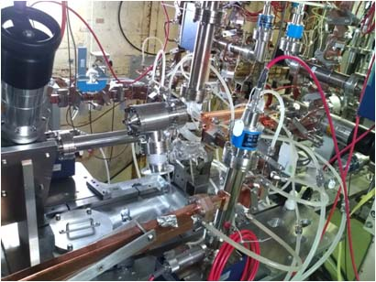
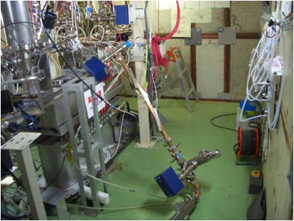
Nextef: before / after earthquake
Running T24
14:46 on March 11, 2011
Unfixed load was fallen
Accelerator structure was found to be atmospheric pressure.

Slide 10
After earthquake
After
Before earthquake
91ns

Slide 11
BD location before and after earthquake
Before
After
Run 32-34 = before at 412nsec, 110-120MV/m
Run 38-39 = after 91nsec, ~100 MV/m
Breakdowns are located uniformly over full accelerator structure span. This behavior has been kept.

Slide 12
Deterioration due to earthquake
WR90 waveguide was ruptured and the structure was purged to almost 1 atm pressure.
Processing memory was gone. Frequent breakdowns made it necessary to reach 100 MV/m even pulse width shortened to 91nsec pulse.
Breakdown location was kept uniform before and after the earthquake.

Slide 13
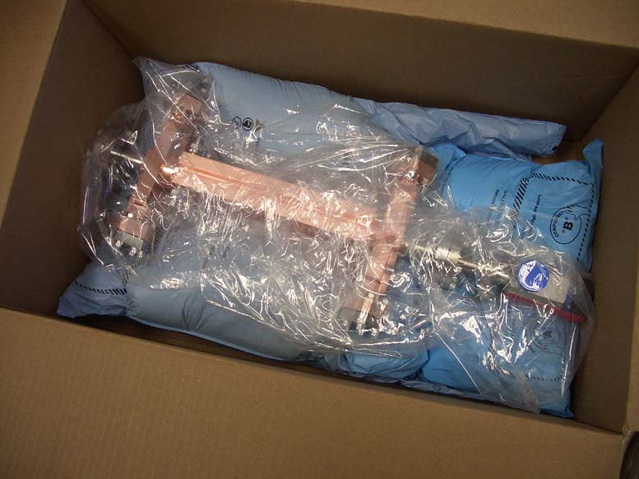
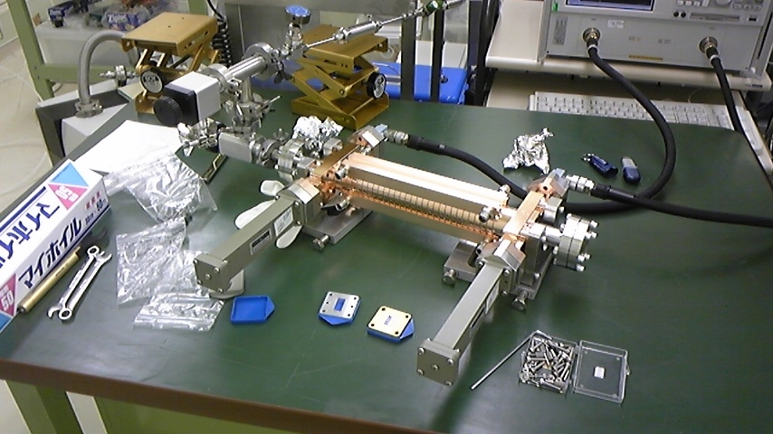
Trial to estimate the frequency change due to HG operation
Total phase advance from input to output
Received from SLAC
Measurement setup at cleanroom
Measurement in cleanroom before HG test

Slide 14
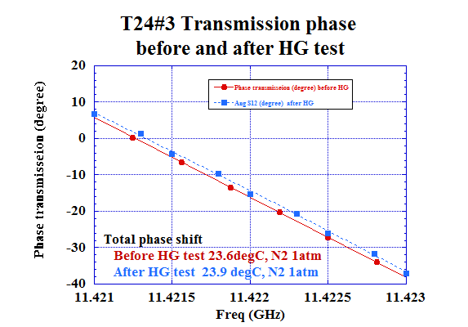
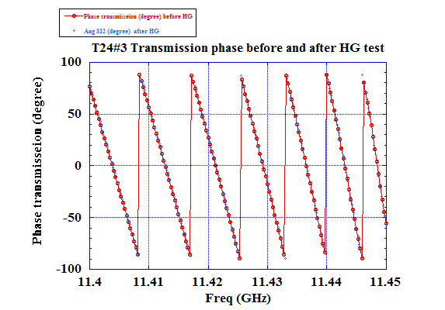
T24#3: Change of total phase shift before to after high-gradient test
Total 2 degrees → roughly +0.16MHz

Slide 15
Estimated frequency change
Actual phase
Freq up by HG
Freq dn by 0.3degC
Less phase advance
+2 deg
Phase reading
Less phase advance after HG
120/cell before HG
0.3 degC → - 0.06MHz
2 degree → +0.1MHz (<vg/c=1.2% assumed)

Slide 16
Deterioration in 10 years?
Roughly speaking, +0.16MHz over 1000hours at 100MV/m
If the same frequency shift continues at the same rate, 10-year operation results in ~10MHz, too large.
Thanks to the BDR reduction as time, we hope this to be much smaller! It should be confirmed in the long running evaluation.
The evaluation should be confirmed with bead pull. It is being prepared now.
It also should be established in an actual prototypes, damped structures.

Slide 17
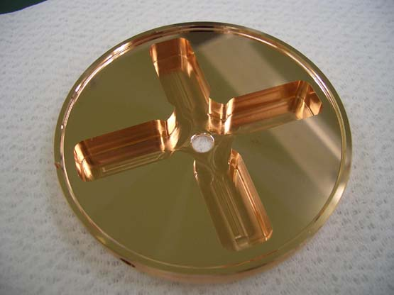
Possible breakdown triggered from high magnetic field area
TD18_Disk
Near max Hs
SEM inspection by CERN on eq. acc str, TD18#3
Pulse heat damage
Hs maximum point
Hs max
Milling + Turning + Light etching < 1μm
Markus Aicheler 13. Oct. 2010
Strange shape at highest Hs point

Slide 18
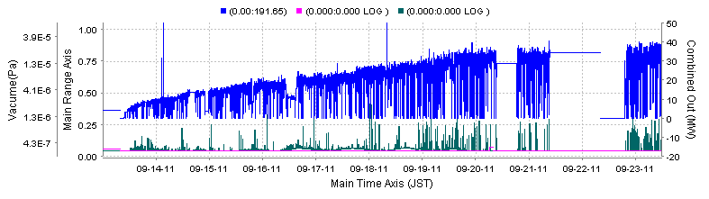
TD24 #4 Initial start up
Power monitor
Waveguide VAC
input and output

Slide 19
Initial stage of TD24#4 processing at 51nsec
Tentative in Eacc
Preliminaly estimated to be a little low
Here and following pages for TD24
Eacc [MV/m] (preliminary)
RF-ON time [hrs]

Slide 20
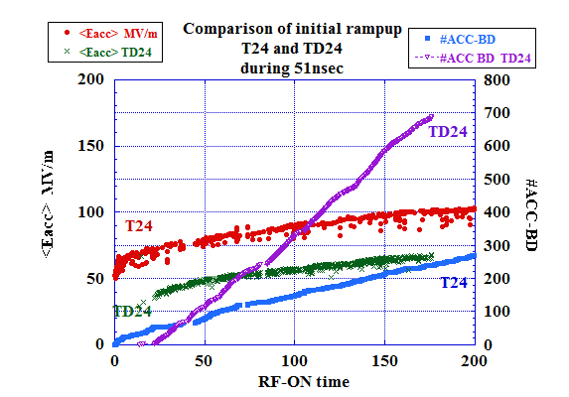
Comparison of initial ramp up
T24 vs TD24

Slide 21
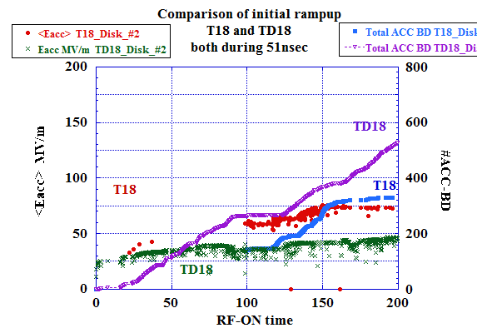
Comparison of initial ramp up
T18 vs TD18

Slide 22
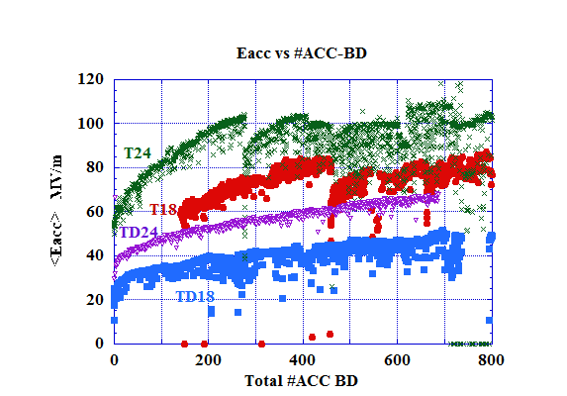
Comparison of initial ramping starting at 51nsec run

Slide 23
Initial startup characteristics
Damped is slower than undamped.
24-cell structures seem faster than 18-cell.
TD24 #4 are being ramped up at initial shortest pulse width 51nsec.
The recovery route and speed from BD is determined by the KEK protocol. (Keep T_{p})

Slide 24
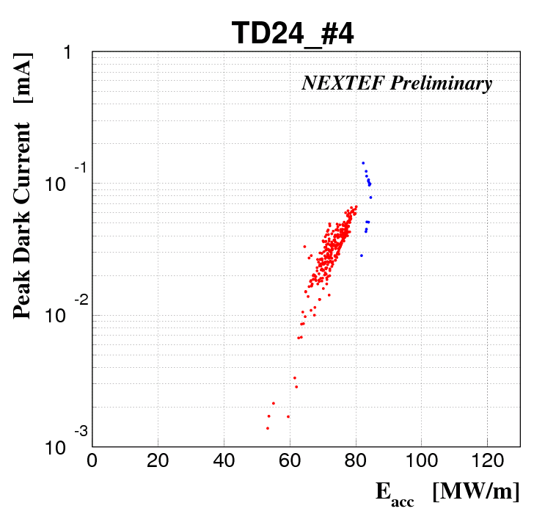
Dark current of TD24#4 in its initial stage of processing with 51nsec
Sep. 16-18
Sep. 27

Slide 25
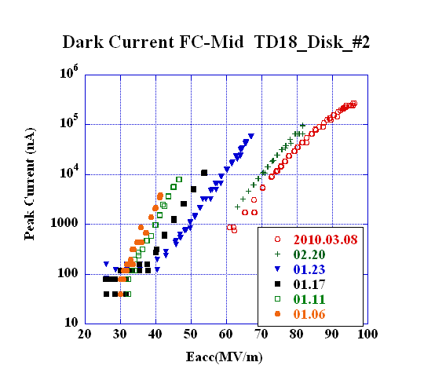
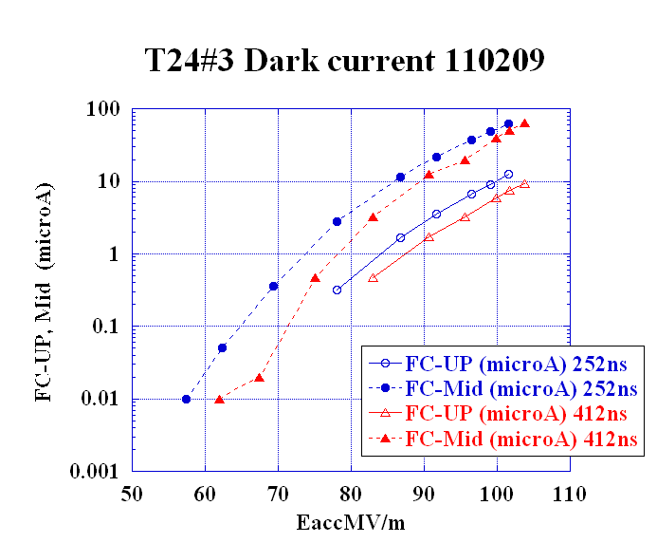
Comparison of dark current
T18_Disk
TD18_Disk
T24_Disk
TD24_Disk
(51ns processing)
Eacc for peak dark current of 10 μ
90MV/m 70MV/m 100MV/m (80MV/m)
Undamped 90~100 MV/m damped 70~80MV/m

Slide 26
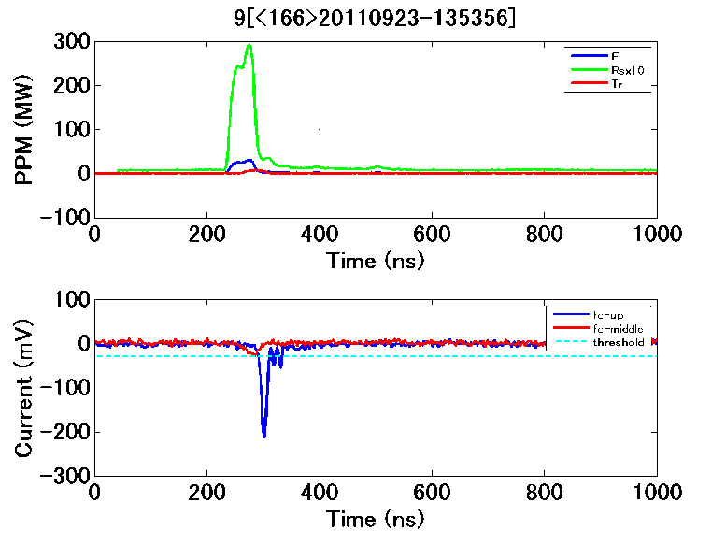
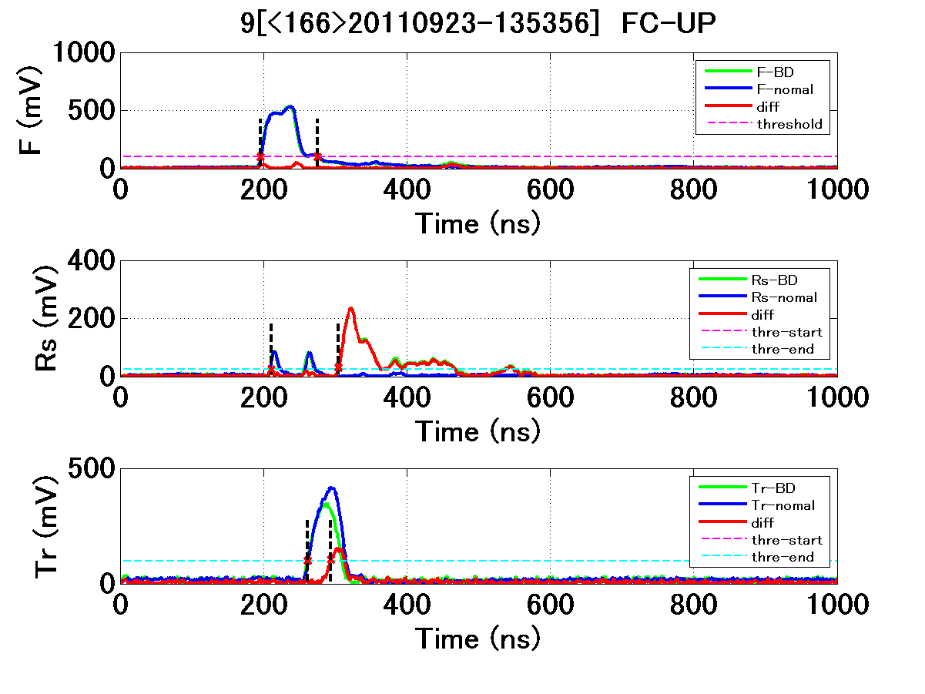
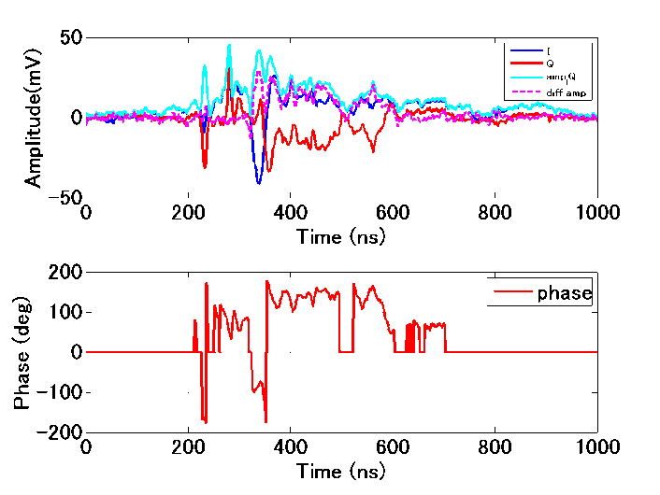
BD Pulse shapes
forward
FC up and Mid
reflected
Reflection I, Q
transmitted
Reflection phase

Slide 27
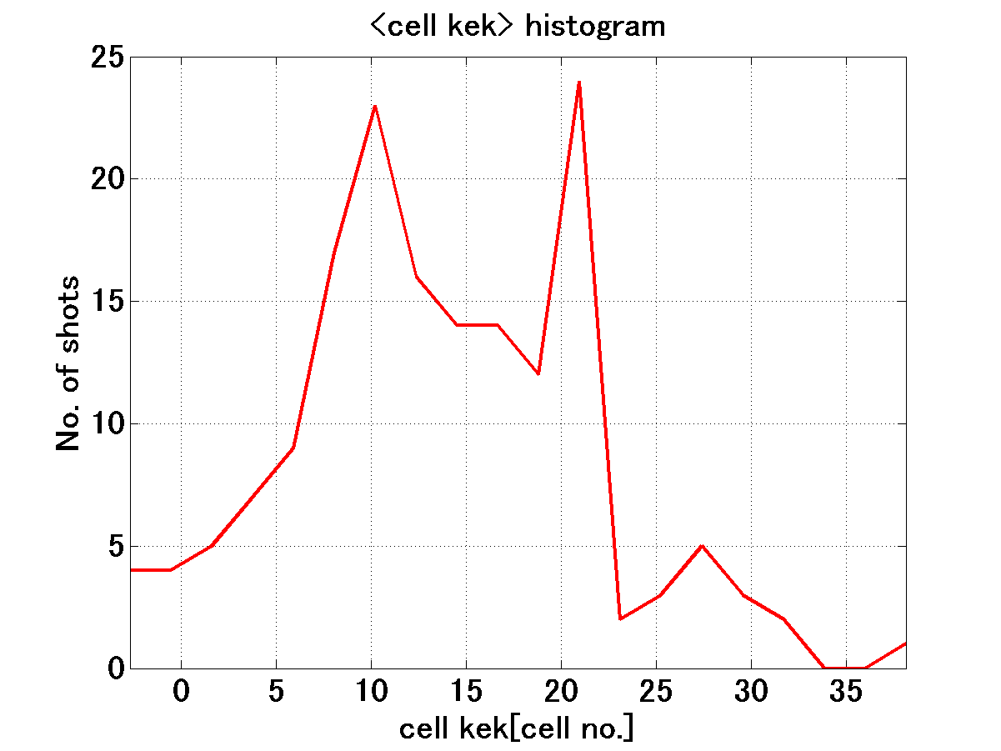
BD cell distribution from RF pulse timing
Rather uniform BD location, but maybe two frequent locations?

Slide 28
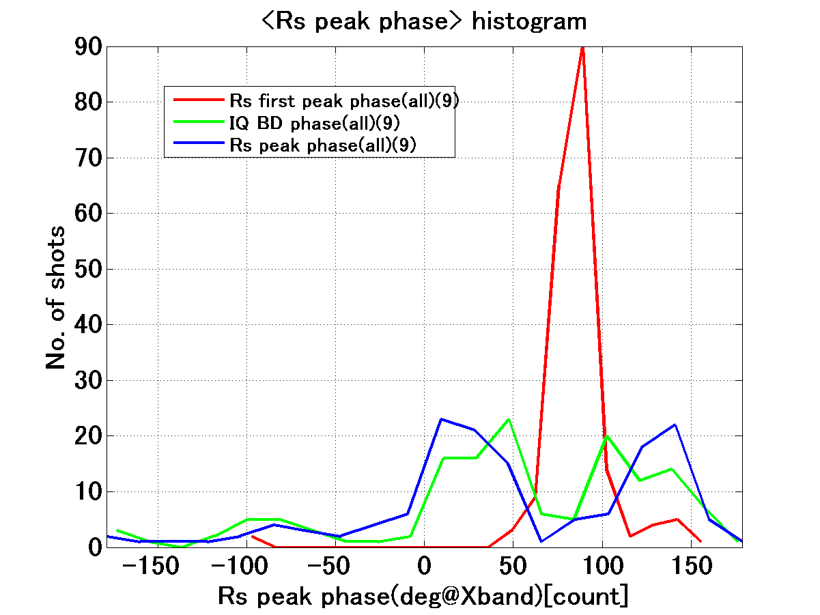
Rs phase
Input spike as a reference of meas. system
BD Rs phase mostly in two phases

Slide 29
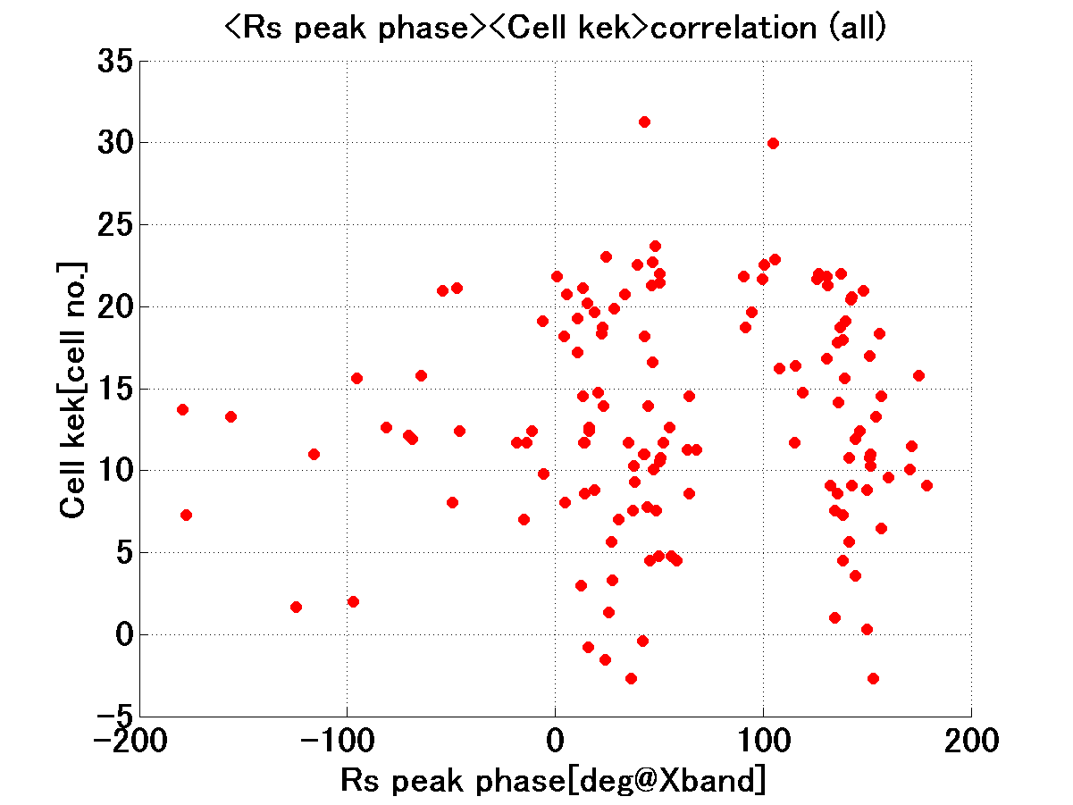
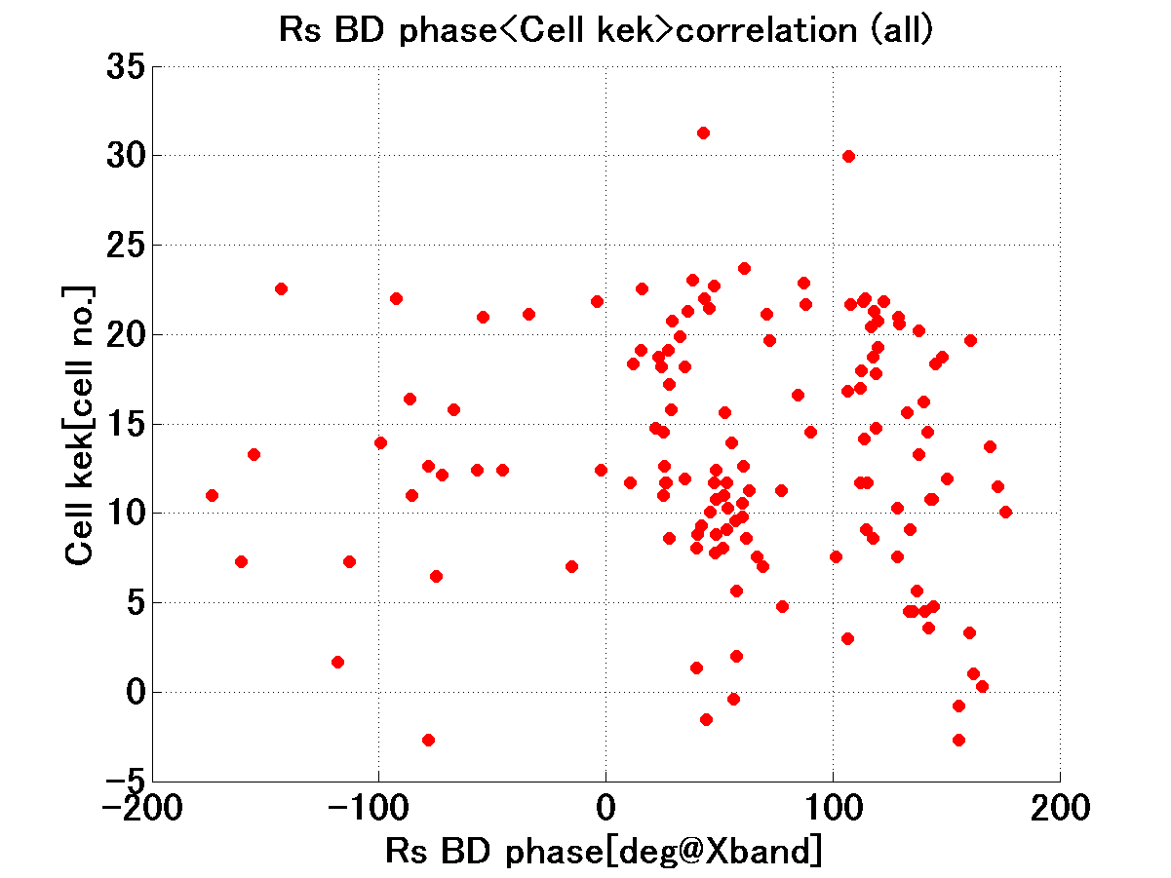
BD-cell location versus Rs phase
BD cell
BD cell
Rs phase at its peak
Rs phase at BD timing
BD cells are uniformly located but Rs in two phases, as described in the previous slides.

Slide 30
Summary of test result TD24#4
Processing speed is faster than TD18 and slower than T24
BD location distribution is roughly uniform
BD reflection phase shows two peaks
Initial-stage dark current is less than TD18 but higher than T24
It is kept running for 24hr/day → need to wait a month to reach nominal CLIC operation

Slide 31
Structure fabrication
TD24R05 #1--#4
  #1--#2 in assembly at SLAC
  #3--#4 on the way to SLAC
TD24R05 12GHz
  Problem found: it prevents from proper stacking
  Additional cut is being made
DDSA 12GHz test cell
  Five test cells will delivered to KEK on Sep. 26
  Stack measurement is in preparation
We are struggling to deduce the relation between machining and high-gradient performance.

Slide 32
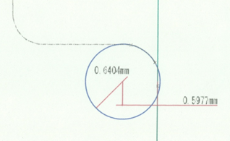
Recently happened problem
Measurement of TD24R05(12GHz)
Bad corner radius shape in male side
Cell stacking schematic with self fitting feature
Same problem may happen in other KEK-made cells!?
It may enhance BD, though without vacuum problem!?

Slide 33
Toward basic study on high gradient
Single-cell setups are being prepared
Large-grain material is included as material to be used to simplify the study
Setup is being prepared at another test stand, called “shield-B” being driven by a single klystron at KT-1.

Slide 34
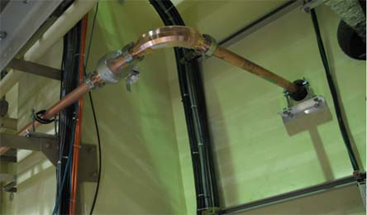
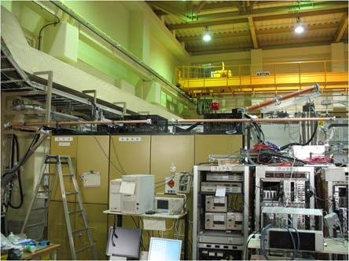
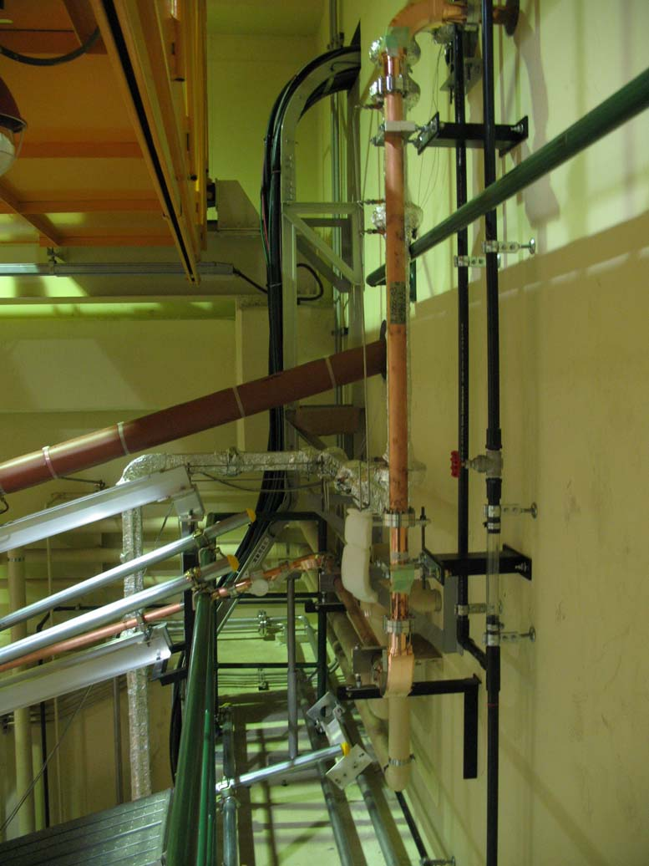
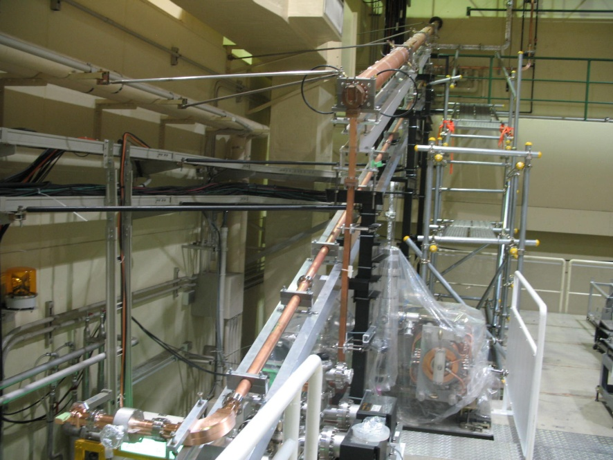
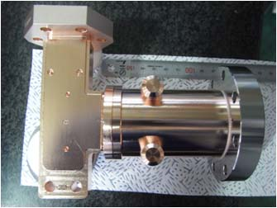
Transport line KT1 to B being constructed
KT1
B

Slide 35
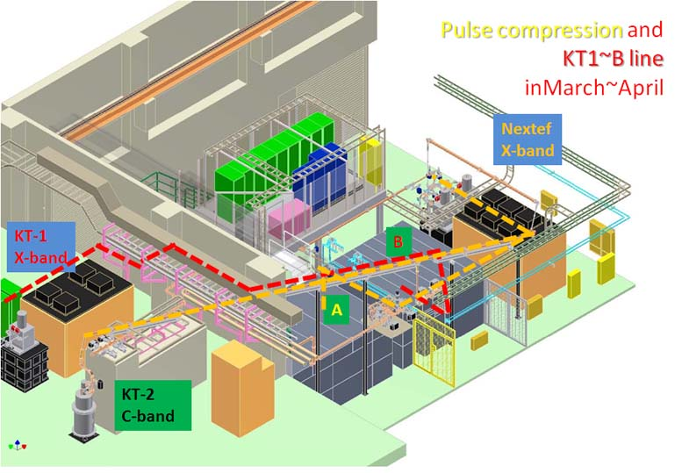
Nextef expansion is being proceeded

Slide 36
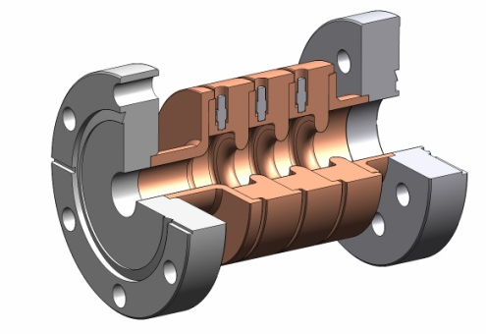
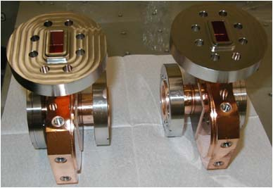
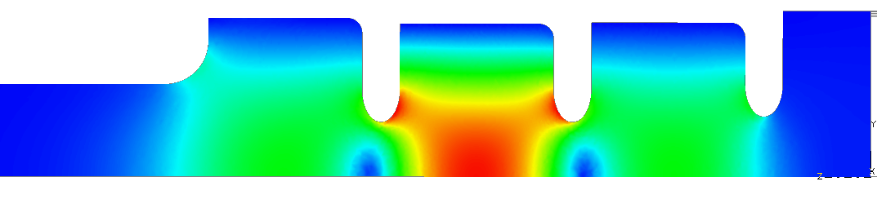
Reusable coupler: TM₀₁ Mode Launcher
Surface electric fields in the mode launcher E_{max}= 49 MV/m for 100 MW
SLAC made a set of launchers for KEK basic tests.
KEK will prepare single cell test setups.
Notes:
基礎試験用
モードロンチャー SLAC製 → KEKで使用
単セル空洞 を 今後の日米資金と協力関係を元に 製作 ＋ 試験 できる

Slide 37
Conclusion
The high gradient test of T24 was finished with low-enough BDR value with its continuing evolution.
Processing of TD24 was recently started. Initial processing speed is slower than T24 but a bit faster than TD18. Sounds reasonably well behaved at 51ns, >80MV/m level now.
Another test system is being constructed for basic studies at KEK.

